Slide 1
Reorganizing
Spokane police Department patrol/Precincts to better serve our mission
The Spokane Police Department is committed to providing excellence in policing, enhancing the safety and security of individuals, and building partnerships to better the lives of our community members as a whole.

Slide 2
Current Staffing status
356 of Commissioned Personnel allotted
16 Vacant Positions (over 30 have left so far this year, expecting additional persons)
20 in Training (Academy/FTO)
22 (rough average) Typically on Light Duty / FMLA
58 Positions Not Available

Slide 3
Officer Ratios
According to FBI the National Average of Police Officers to Population is 2. 4 per 1,000 persons
Washington State is among the very last in the Nation
Spokane is 1.62 per 1,000
We would need 169 Additional Officers to be at National Average

Slide 4
Impacts: Slower response times
Comparing the response times from the first quarter of 2021 to 2022:
Priority 1 increased 10.7%
Priority 2 increased 23.7%
Priority 3 increased 28.4%
(to more than an hour for 3’s)

Slide 5
Other Contributing factors
Washington State Law Enforcement Reforms of 2020 Require More Officers and More Time – Critical Incident Management
Same number of Officers
Total Calls for Service (next slide)

Slide 6
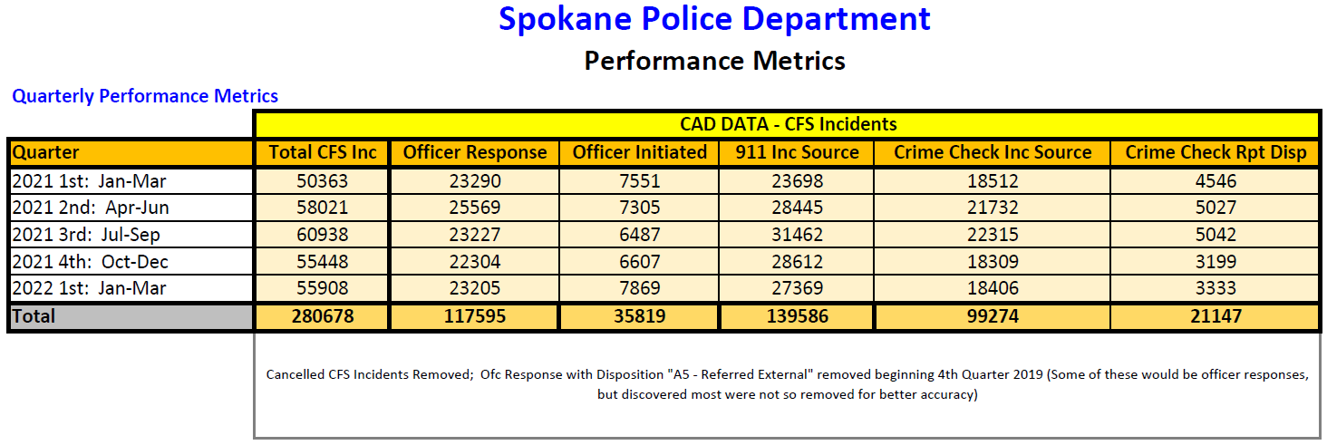

Slide 7
Impacts: Mandatory Overtime
Shift Coverage
Special Events
Bar Patrol ($138,000 through August of 2022)
Costs

Slide 8
Impacts: COntinued
Officer Burn Out
Officer Morale
Difficulty Recruiting / Hiring

Slide 9
Current Patrol Staffing Model
-1 Captain
-8 Lieutenants
-16 Sergeants
-16 Corporals
-120 Officers (Includes 3 OOG Detectives)
-6 Light Duty Officers (Not Included in Above #)
*7/28/22

Slide 10
Current Precinct Staffing
-1 Captain
-1 Lieutenants
-0-1 Sergeants (Downtown not included)
-1-3 Detectives
-3-4 NRO’s (Downtown not included)

Slide 11
Proposed Patrol staffing Model for January 2023
-1 Major
-4 Captains
-11 Lieutenants
-22 Sergeants
-16 Corporals
-154 Officers working over a three shift, 10 area model
-Adam, Baker, Charlie and David sectors with NRO boundaries (10) as subsets in which Captains can assure neighborhood issues are addressed by permanently assigned officers and increased supervision.
-Sectors can provide support on very busy days, but area integrity is important.

Slide 12
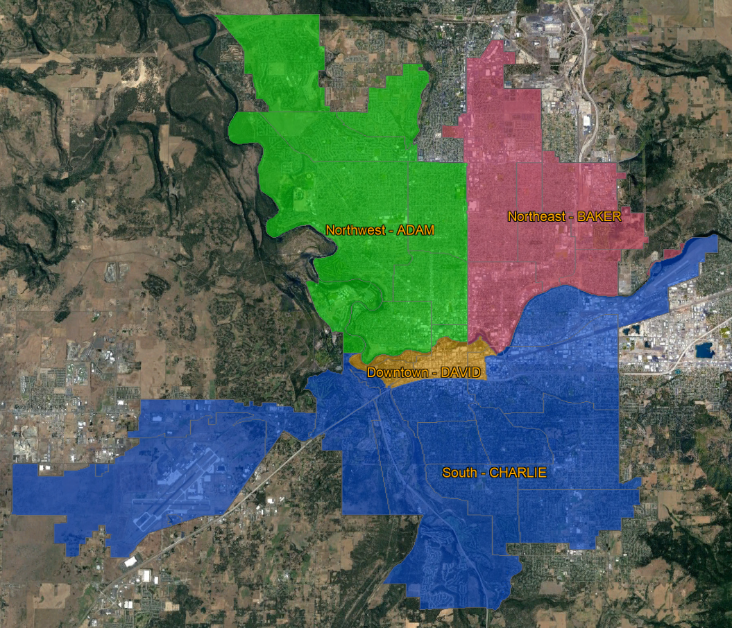
MAP

Slide 13
Staffing Source
NRO’s
DV Officers
Traffic Unit (minus DUI cars)
Other officer held positions within SPD
Condensing from 4 shifts to 3 shifts

Slide 14
Transition Date
New configuration will go into effect on January 8th
We are already making moves within SPD to lay the foundation for this transition
  Re-assigned Detectives to Investigations (from Precincts)
  Assignment of Lieutenants
  Captains meeting regularly, going over now procedures, protocols, expectations

Slide 15
Challenges
Public’s access to NRO’s / How will they deal with Neighborhood Issues
  Public will still have a person within each Precinct to contact – designated by each Precinct Captain
This is a paradigm shift for most levels within SPD
Organization change takes consistent time and effort / can be difficult

Slide 16
Goals for Transition
Decrease Response Time to Calls for Service
Put More Officers on the Streets to respond and be pro-active
Eliminate Bar Patrol
Reduce/eliminate other mandatory overtime
Dramatically Decrease Overtime Spending
Increase Officer Morale - Reduce Fatigue / Burn-Out
Create Early and Late David (Downtown) Sector

Slide 17
Goals for Transition
Return to a truer Community Oriented Policing
  All officers are NRO’s
  Officers develop Ownership if Neighborhoods/Areas
  All officers do traffic enforcement
  Lays a solid foundation for growth into the future
  Give Resources to Precinct Captains to enable them to address problems in Precinct

Slide 18
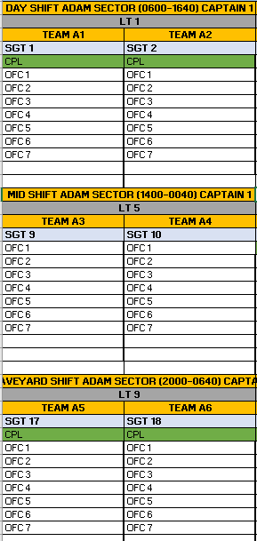
Captain’s will have a large contingent of officers which can address specific neighborhood issues. Each district’s call demand can be re-assessed annually to determine proper staffing levels. There has been an algorithm developed to assess these proper staffing levels.

Slide 19
Goals for transition
Most Importantly, live up to our mission in providing excellence in policing, enhancing the safety and security of individuals, and building partnerships to better the lives of our community members as a whole

Slide 20
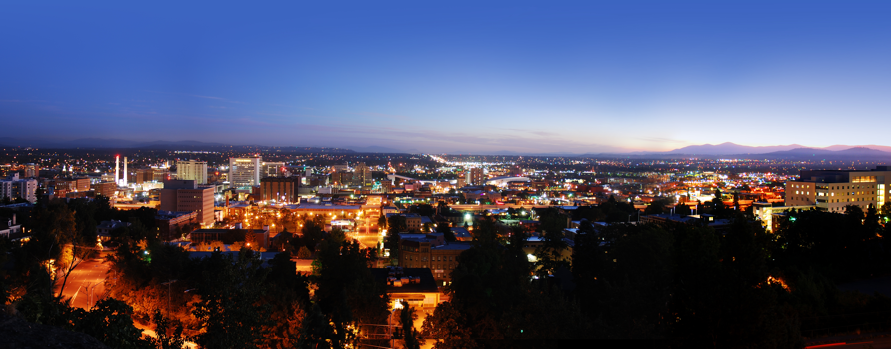
Questions and feedback

